Slide 1
Autonomous Vehicle ROS Navigation in 5 Days
Shoval Nakash 207207838
Adi Gredi 316063353
Liad Arama 206484719

Slide 2
Course Objective
The objective of this course is to give you the basic tools and knowledge to be able to understand and create any basic ROS Navigation related project.
this course will give the ability to create maps of environments, localize the robot in the environment, make the robots perform path planning, visualize data of the different Navigation processes and debug errors using Rviz.
The course will allow to understand Navigation packages that others have done. So, ROS code that made by others can be taken by you and after understanding it you can modify it for your own purposes.
This course can serve as an introduction to be able to better understand the official ROS Navigation documentation or external Navigation documentation and projects.

Slide 3
Definitions
ROS: Robot Operating System is an open-source robotics middleware suite. Although ROS is not an operating system but a set of software frameworks for robot software development, it provides services designed for a heterogeneous computer cluster such as hardware abstraction, low-level device control, implementation of commonly used functionality, message-passing between processes, and package management.
Rviz: is a powerful robot visualization tool. It provides a convenient GUI to visualize sensor data, robot models, environment maps, which is useful for developing and debugging your robot controllers.
Autonomous Navigation: means that a vehicle is able to plan its path and execute its plan without human intervention. In some cases remote navigation aids are used in the planning process, while at other times the only information available to compute a path is based on input from sensors aboard the vehicle itself.

Slide 4
Autonomous Navigation Overview
Autonomous navigation means that a vehicle is able to plan its path and execute its plan without human intervention.
Localization: The robot needs to know where it is.
Mapping: The robot should be able to build a virtual representation of its environment.
Path Planning: The robot needs to be able to plan a route.
Motion Control: The robot has to be able to follow a planned trajectory.
Major challenges of Robot Navigation
Localization
Mapping
Path Planing
Motion Control
Global
Global
Local
Global
Global
Local
Local
Local

Slide 5
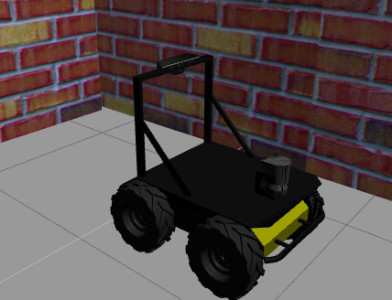
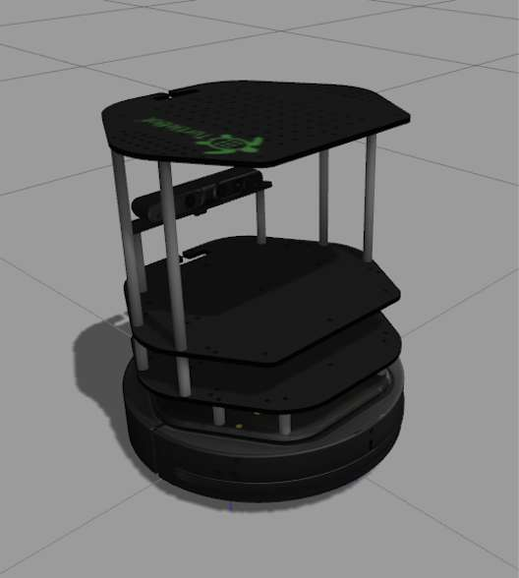
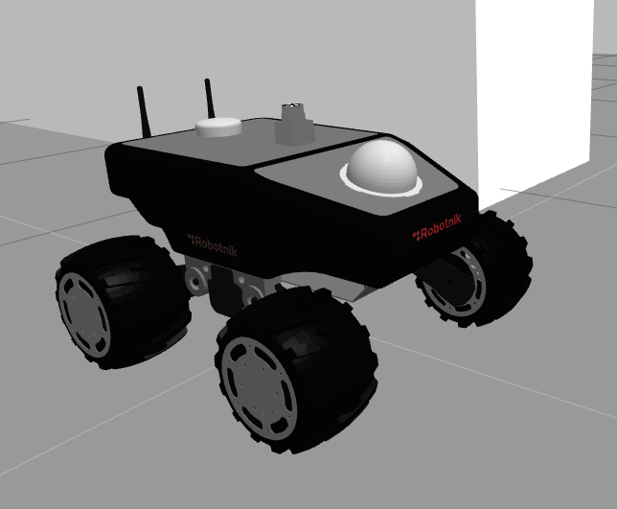
Robot’s Models in the course:
Kobuki
Husky
Summit XL

Slide 6
Mapping
In order to perform autonomous Navigation, the robot MUST have a map of the environment.
The robot will use the map for many things such as planning trajectories, avoiding obstacles, etc.
You can either give the robot a prebuilt map of the environment, or you can build one by yourself which is quite more frequent. And than the robot will use it.

Slide 7
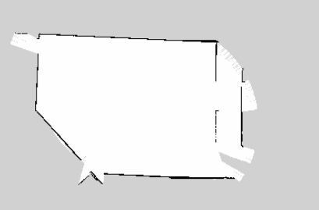
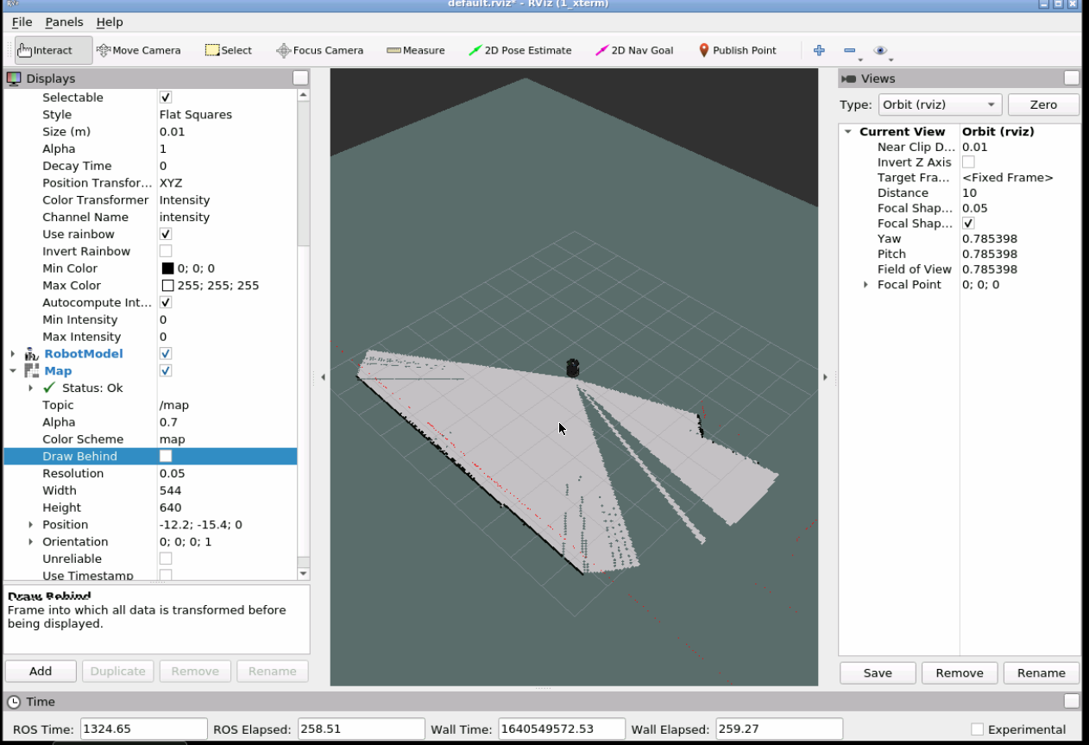
How to Create a Map
The course presents some tools to visualize maps, robots and objects.
In the picture below the Robot is using a laser to map the surroundings
RVIZ is using to visualize it.
There is also an option to export the map to PGM file.

Slide 8
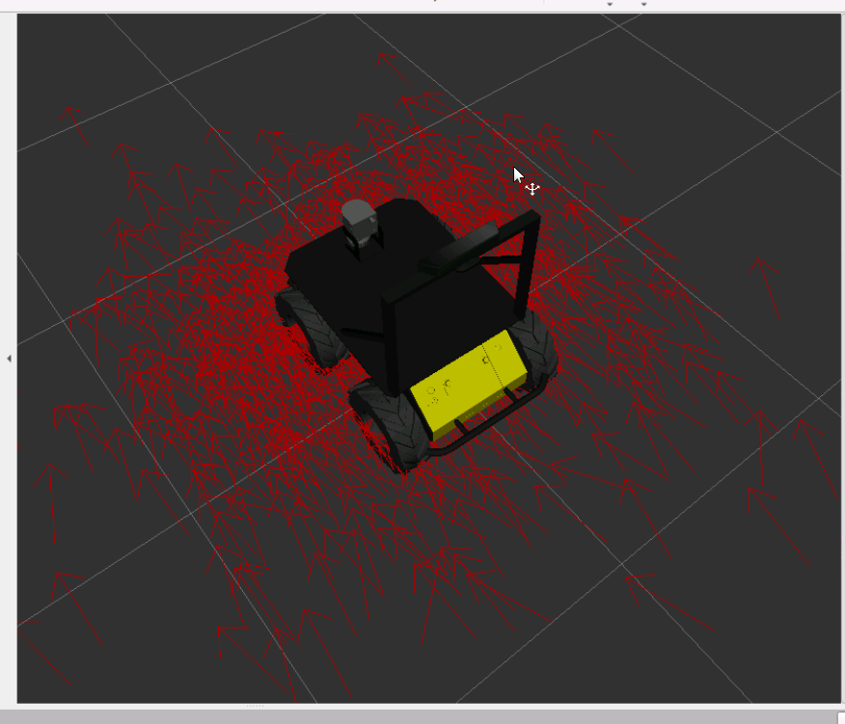
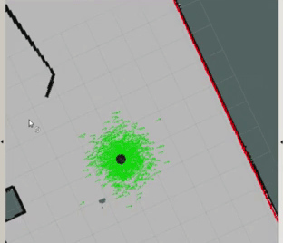
Localization
When the robot moves around a map, it needs to know what is its position within the map, and which is it’s orientation.
Determining it’s location and rotation, ultimately will grant a high level of accuracy which enables a self-driving robot to understand it’s surroundings and also, establish a sense of the road and lane structures.
Monte Carlo, is one of the algorithms that the robot uses for localization within the map. Those arrows represents location and orientation guesses of the robot in the map as a result of the Monte Carlo Algorithm. The arrows will concentrate on the most likely location and will get more accurate when the robot is on the move.

Slide 9
How to Plan a Path:
The global path planner is concerned with long range planning and uses the available map information, which can be slow, but is key to finding the most efficient path to a distant goal. It’s not concerned with the robot's dynamics or how to avoid unexpected obstacles, which are left to the local path planner.
The global planner - will calculate a safe path for the robot to use to arrive to the specified goal. The global planner uses the global costmap data in order to calculate this path.
The local planner - uses data from the Global Planner and breaking it into smaller parts. By that, its achieving information about obstacles and control the robot movement. The local planner operates over a local costmap.
Note - There are different types of Global and Local Planners depending on you setup and main goal.

Slide 10
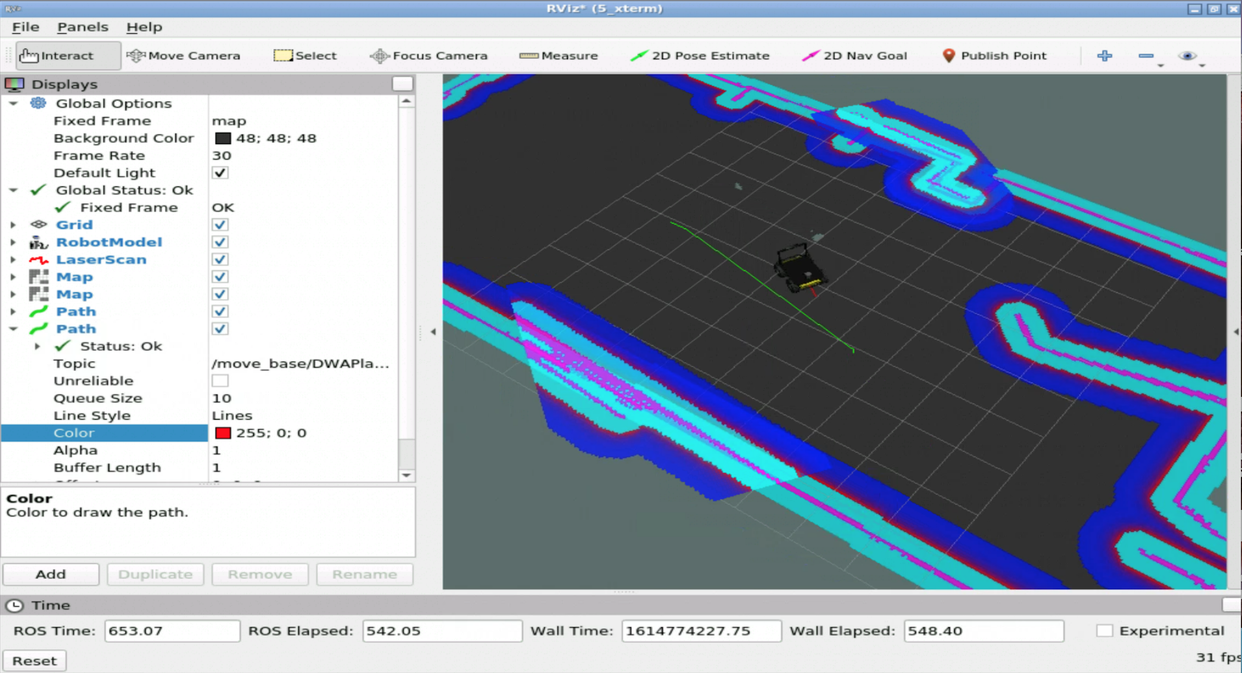

How to Plan a Path:
Costmaps - A costmap is a map that represents places that are safe for the robot to be in a cells grid. Usually, the values in the costmap are binary, representing either free space or places where the robot would be in collision. For Example: 0 represent cells where there are no obstacles and, therefore, moving the center of the robot to this position will not result in a collision.
Global plan – Green
Local plan - Red
Dijkstra Algorithm Visualization

Slide 11
Motion Control
The robot has to be able to follow a planned trajectory. During autonomous navigation we are using Odometry for a real time positioning information in order to make sure that the movement will not end up with a collision.
In wheeled mobile robots, the odometry estimates its position relative to a starting
location.
Odometry - is the use of data from motion sensors to estimate change in position over time. It is used in robotics by some legged or wheeled robots to estimate their position relative to a starting location. This method is sensitive to errors due to the integration of velocity measurements over time to give position estimates. Rapid and accurate data collection, instrument calibration, and processing are required in most cases for odometry to be used effectively.

Slide 12
Summary
In this course we learned the key and essential concepts of ROS Navigation, which allow robots to move around autonomously in various fields: warehouses, domestic, entertainment.
The following concepts were learned:
01
03
05
Setup ROS Navigation Stack on a Robot
Perform Robot Localization
Understanding Localization and Mapping
04
06
02
Autonomous Path Planning
Obstacle Avoidance
Building a map of the environment

Slide 13
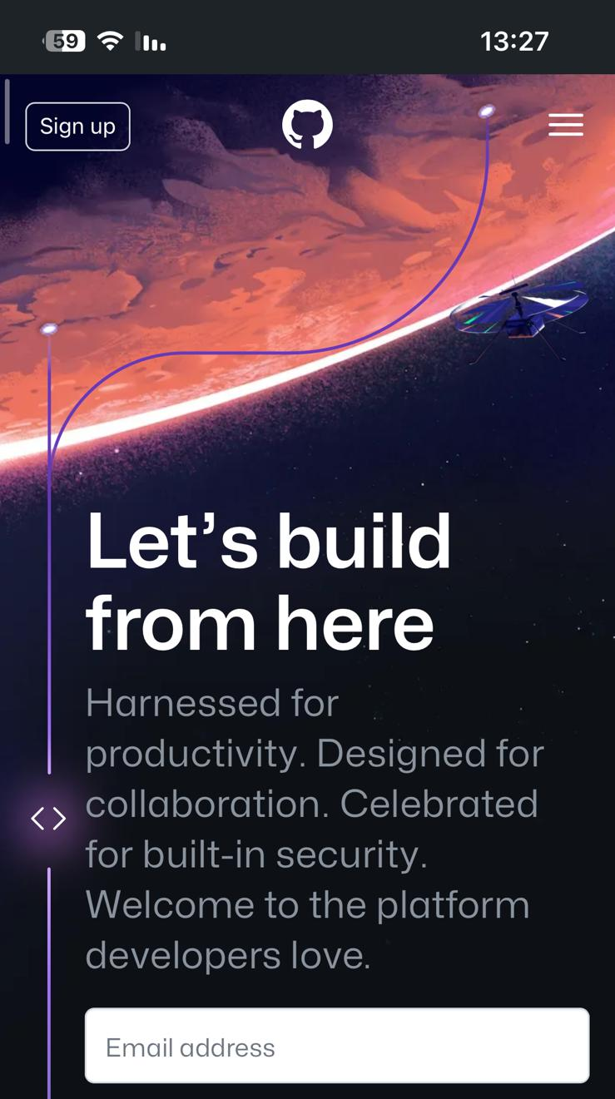




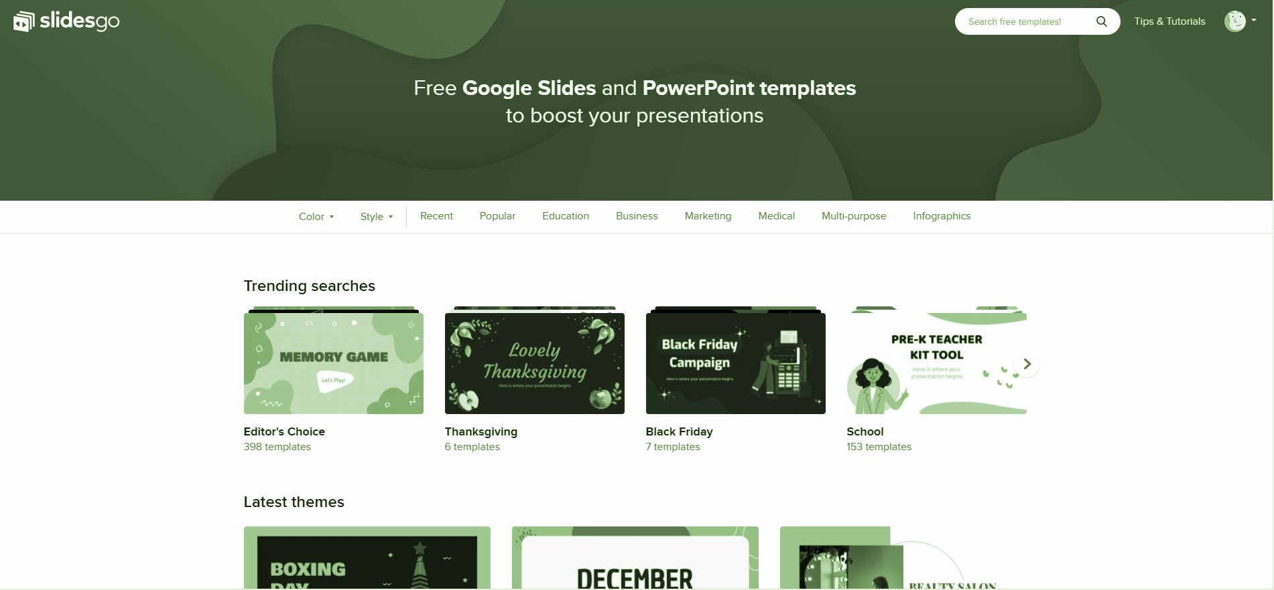
GitHub
Video: https://www.youtube.com/watch?v=uI21y1WpGWM
Project: https://github.com/shovalnakash/Software-Development-for-Intelligent-Autonomous-Vehicles

Slide 14
Sources
https://app.theconstructsim.com/Course/57/
https://en.wikipedia.org/wiki/Odometry
https://en.wikipedia.org/wiki/Robot_Operating_System
http://wiki.ros.org/rviz
https://www.accessscience.com/content/article/aYB000130
https://navigation.ros.org/

